Slide 1
CS 252 Database Management Systems
Jan – May 2020
IV Semester
* Use the slides for reference only. Refer the text book for details.

Slide 2
Overview of Database Design Process
Two main activities:
Database design
Application design
Focus is on conceptual database design
To design the conceptual schema for a database application
Applications design focuses on the programs and interfaces that access the database
Generally considered part of software engineering

Slide 3
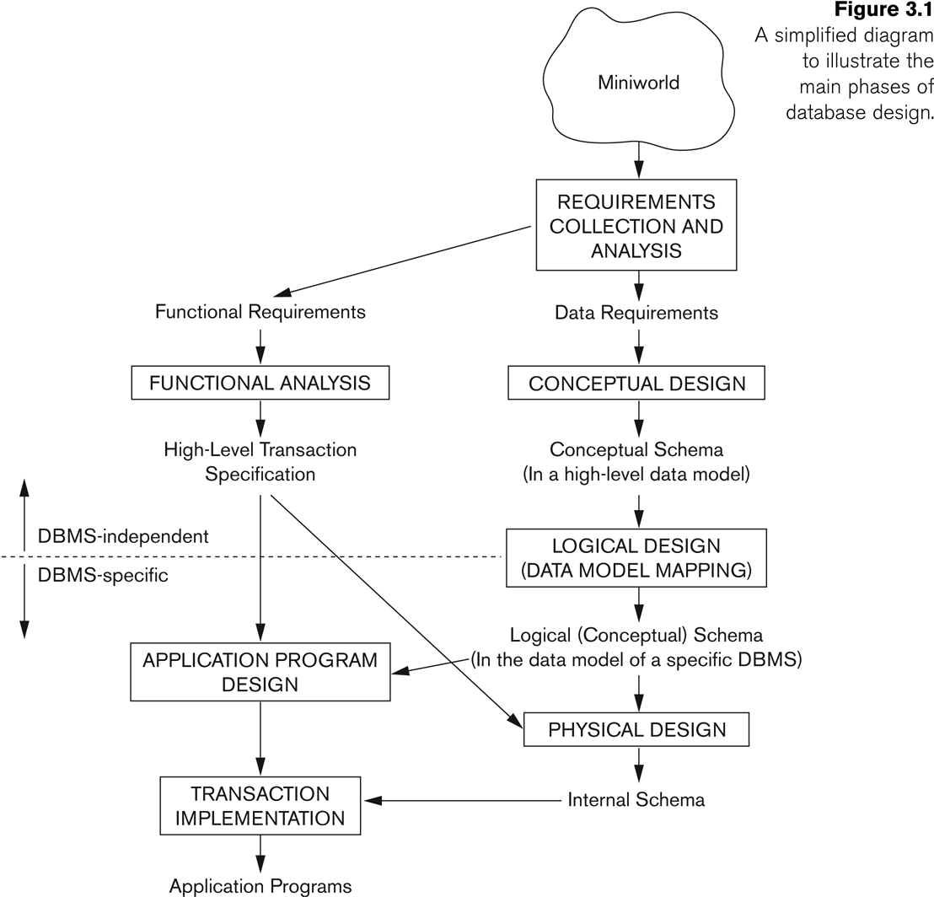
Overview of Database Design Process

Slide 4
ER Model concepts
Entities and Attributes
Entity is a basic concept for the ER model. Entities are specific things or objects in the mini-world that are represented in the database.
For example the EMPLOYEE John Smith, the Research DEPARTMENT, the ProductX PROJECT
Attributes are properties used to describe an entity.
For example an EMPLOYEE entity may have the attributes Name, SSN, Address, Sex, BirthDate
A specific entity will have a value for each of its attributes.
For example a specific employee entity may have Name='John Smith', SSN='123456789', Address ='731, Fondren, Houston, TX', Sex='M', BirthDate='09-JAN-55‘
Each attribute has a data type associated with it – e.g. integer, string, date, enumerated type, …

Slide 5
Types of attributes
Simple
Each entity has a single atomic value for the attribute. For example, SSN
Composite
The attribute may be composed of several components.
For example:
Address(Apt#, House#, Street, City, State, ZipCode, Country)
Name(FirstName, MiddleName, LastName)
Composition may form a hierarchy where some components are themselves composite.
Multi-valued
An entity may have multiple values for that attribute. For example, PreviousDegrees of a STUDENT.
Denoted as {PreviousDegrees}.
In general, composite and multi-valued attributes may be nested arbitrarily to any number of levels, although this is rare.
For example,
PreviousDegrees of a STUDENT is a composite multi-valued attribute denoted by {PreviousDegrees (College, Year, Degree, Field)}
Multiple PreviousDegrees values can exist. Each has four subcomponent attributes: College, Year, Degree, Field

Slide 6
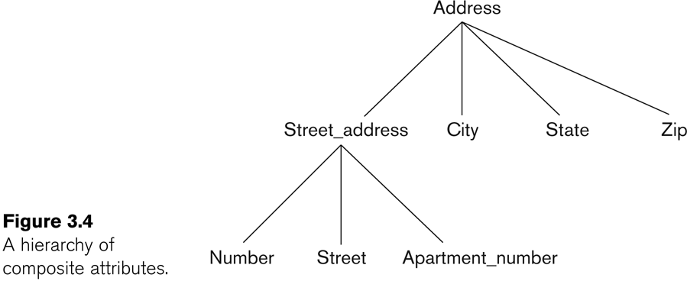
Example of composite attribute

Slide 7
Entity Types and Key Attributes
Entities with the same basic attributes are grouped or typed into an entity type.
For example, the entity type EMPLOYEE and PROJECT.
An attribute of an entity type for which each entity must have a unique value is called a key attribute of the entity type.
For example, SSN of EMPLOYEE.
A key attribute may be composite.
VehicleChassisNumber, VehicleEngineNumber is a key of the CAR entity type with components (ChassisNumber, EngineNumber).
An entity type may have more than one key.
The CAR entity type may have three keys:
VehicleIdentificationNumber (popularly called VIN)
VehicleRegistrationNumber aka license plate number.
VehicleChassisNumber, VehicleEngineNumber
Each key is underlined (Note: this is different from the relational schema where only one “primary key” is underlined).

Slide 8
Entity set
Each entity type will have a collection of entities stored in the database
Called the entity set or sometimes entity collection
Previous slide shows three CAR entity instances in the entity set for CAR
Same name (CAR) used to refer to both the entity type and the entity set
However, entity type and entity set may be given different names
Entity set is the current state of the entities of that type that are stored in the database

Slide 9
Value Sets (Domains) of Attributes
Each simple attribute is associated with a value set
E.g., Lastname has a value which is a character string of upto 15 characters, say
Date has a value consisting of MM-DD-YYYY where each letter is an integer
A value set specifies the set of values associated with an attribute

Slide 10
Attributes and Value Sets
Value sets are similar to data types in most programming languages – e.g., integer, character (n), real, bit
Mathematically, an attribute A for an entity type E whose value set is V is defined as a function
A : E -> P(V)
Where P(V) indicates a power set (which means all possible subsets) of V. The above definition covers simple and multivalued attributes.
We refer to the value of attribute A for entity e as A(e).

Slide 11
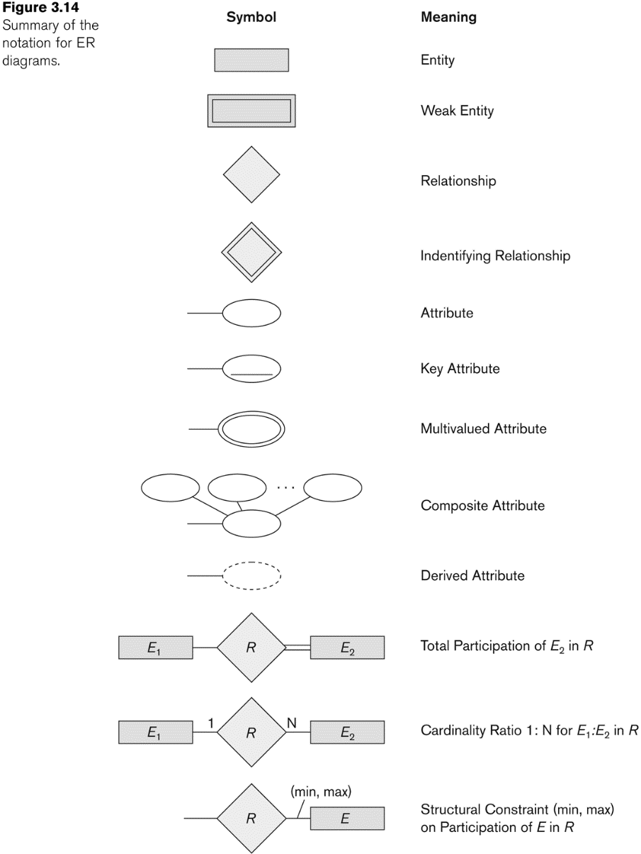
ER Diagram Notation

Slide 12
Example COMPANY Database
We need to create a database schema design based on the following requirements of the COMPANY Database:
The company is organized into DEPARTMENTs. Each department has a name, number and an employee who manages the department. We keep track of the start date of the department manager. A department may have several locations.
Each department controls a number of PROJECTs. Each project has a unique name, unique number and is located at a single location.

Slide 13
Example COMPANY Database
The database will store each EMPLOYEE’s social security number, address, salary, sex, and birthdate.
Each employee works for one department but may work on several projects.
The DB will keep track of the number of hours per week that an employee currently works on each project.
It is required to keep track of the direct supervisor of each employee.
Each employee may have a number of DEPENDENTs.
For each dependent, the DB keeps a record of name, sex, birthdate, and relationship to the employee.

Slide 14
Example COMPANY Database
Based on the requirements, we can identify four initial entity types in the COMPANY database:
DEPARTMENT
PROJECT
EMPLOYEE
DEPENDENT
Their initial conceptual design is shown on the following slide
The initial attributes shown are derived from the requirements description

Slide 15
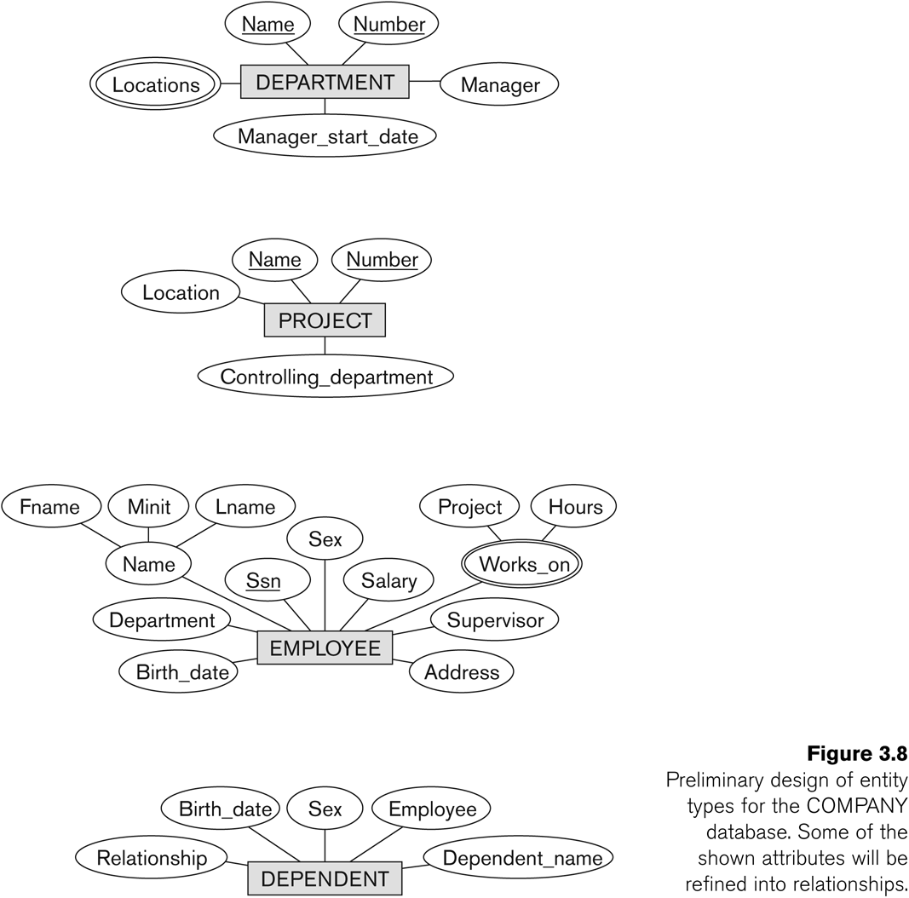
Initial Design of Entity Types:

